Slide 1
New Recruits-What does it take to attract the younger generation
Ann Thor, M.D.

Slide 2
The Multigenerational Workforce-4 generations
1927-1945 The Traditionalists
1946-1964 The Baby Boomers
1965-1980s Generation X
1980-present Generation Y

Slide 3
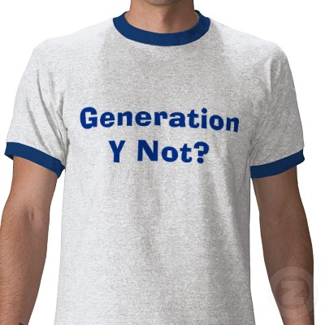
Gen Y: the Millennials
70 Million
1 in three a minority
Many graduate from med
school with 100-200K debt…

Slide 4
Gen Y: Life is short
9/11, wars and unstable economy a big influence
Willing to trade high pay for fewer hours, flexible schedules
Men expect to be able to contribute more with family, both sexes expect flexibility
High expectations of their employers

Slide 5
Gen Y: a culture all their own
Question everything (what do you mean you have rules and assignments)
Multi-taskers
Team Oriented
About change
They want to work, but they don't want work to be their life.
Confident, ambitious and self-assured (have a thing with academic hierarchy)

Slide 6
Gen Y: Tech-savvy
Technology a requisite for their practice of medicine.
Plugged-in 24/7
Recruitment, communication through social media, email and text messaging
Prefer webinars and online technology to didactic format

Slide 7
Gen Y: They want attention
More frequent interaction with leadership
Immediate feedback
Mentoring: have to be concrete

Slide 8
Generation X: 1965 to early 1980s
Independent, resourceful and self-sufficient
Value freedom and responsibility.
Technologically adept
Flexible, adaptive
Tolerant of alternative lifestyles.
Work hard/play hard mentality.

Slide 9
Gen X: What do they want?
Freedom to work hard and succeed without micromanagement
Respect, recognition of their values
Flexibility in work structure, hours, rules
Want to work to live, rather than live to work

Slide 10
The Boomers: 1946 to 1964
Work-Centric
….Believe X and Y should pay their dues, work harder and conform to their culture
Independent and not afraid of confrontation
Goal and achievement oriented
Equate work and position with self-worth.
Competitive, want to win and often in control

Slide 11
The Traditionalists: DOB before 1945
Hardworking and storic
Loyal, civic minded
Submissive, respect authority
Paternalistic
Tech-Challenged
Traditional

Slide 12
What motivates others?

Slide 13
Abraham Maslow’s Pyramid of Needs 1908-70
Self Actualization
Esteem: to self and from others
Social Needs: Belonging, Love
Safety Needs: Security and safety
Physiological: Hunger, Thirst, Comfort

Slide 14
Skinner’s Theory of Reinforcement 1963
Behavior that leads to positive outcomes will be repeated. Negative outcome associated behaviors will not
Praise and positively reinforce to encourage repetition
Negative reinforcement should only be used to prevent unsafe practices

Slide 15
Adam 1965
Employees strive for equity between themselves and other workers

Slide 16
Ohio State University Study Linder 1998
Interesting work and good pay are key
Useful Reward Systems
Job enrichment and promotion
Internal and external stipends, monetary
Non-monetary compensation

Slide 17
OSU Study II: Motivating Factors in Rank Order
Interesting work
Good wage
Full appreciation of work done
Job security
Good working conditions
Promotions and growth opportunities
Updated and communicated to
Personal loyalty to employees
Tactful discipline
Sympathetic help with personal problems

Slide 18
Minority Recruitment, Retention and Career Transition Practices
In 2000 30% of population of US is minority
By 2050 minorities will represent 50%
Predicted labor shortages make it essential to recruit and retain women and minorities
Recruitments must be personalized to the specific needs and barriers of each group
Media representations and real culture must include and respect people of diverse race, sex, age, religion, etc….

Slide 19
To Attract Generation Y
Promote and maintain a team environment…
In and out of workplace
Equitable distribution of responsibilities and perks
Open communication and sharing of data to develop sense of trust
Inclusive not exclusive

Slide 20
And….
A personalized approach makes a difference…find individuals that connect and use them.
Work with candidate to identify their goals, set expectations, craft unique path. This may require mentoring as well as an investment of resources to make it happen.
Show flexibility and respect for work/life boundaries
Use technology and social media for recruitment, communication, education

Slide 21
Resources
Armour, S, USA TODAY, Generation Y: They've arrived at work with a new attitude
Kane, Sally, Generation Y, retrieved from http://legalcareers.about.com/od/practicetips/a/GenerationY.htm on October 26, 2011
Prince, D.E. Generation X and Y Physicians: Lack of Work Ethic?. CMSR | March/April 2009
Perry, Russell, Want to attract and retain Gen Y? Better rethink everything, http://www.azcentral.com/business/articles/2008/09/16/20080916bizaz-geny0908-ON.html#ixzz1bujIXgoz

Slide 22
Resources
ASCP Course Handout, Staff Motivation and Retention, N Soudi
Polodi LH. Helping Medical School Faculty Realize Their Dreams: An innovative, collaborative mentoring program. Academic Mediciine, vol 77, 2002
ASCP 2011 Vacancy Survey, Garcia E et al.
Intersociety Committee on Pathology Education (ICPE)

